Slide 1
Test Automation Engineering Fundamentals: Java
Module 8: Collections
Instructor Disha Mehta

Slide 2

Module Objectives
At the end of this module, participants will be able to:
Define collections
Explain List
Explain Map
Explain HashSets
2
Notes:
Key Message: NA

Slide 3
Java Collections
The Java Collections API's provide Java developers with a set of classes and interfaces that makes it easier to handle collections of objects.
In a sense Collection's works a bit like arrays, except their size can change dynamically, and they have more advanced behavior than arrays.
3
Notes:
Key Message: NA

Slide 4
Collections types
The following interfaces (collection types) extends the Collection interface:
List
Set
SortedSet
NavigableSet
Queue
Deque
4
Notes:
Key Message: NA

Slide 5
Java Collections example
5
Notes:
Key Message: NA

Slide 6
Java Collections - Iterable
The Iterable interface (java.lang.Iterable) is one of the root interfaces of the Java collection classes. The Collection interface extends Iterable, so all subtypes of Collection also implement the Iterable interface.
The Collection interface just defines a set of methods (behaviour) that each of these Collection subtypes share. This makes it possible ignore what specific type of Collection you are using, and just treat it as a Collection.
6
Notes:
Key Message: NA

Slide 7
Java Collections - Iterable
The Iterable interface (java.lang.Iterable) is one of the root interfaces of the Java collection classes. The Collection interface extends Iterable, so all subtypes of Collection also implement the Iterable interface.
List list = new ArrayList();
for(int i=0; i<list.size; i++)
{
Object o = list.get(i);
//do something o;
// o -> list.get(i);
}
7
Notes:
Key Message: NA

Slide 8
Java Collections - Iterable
The Iterable interface (java.lang.Iterable) is one of the root interfaces of the Java collection classes. The Collection interface extends Iterable, so all subtypes of Collection also implement the Iterable interface.
List list = new ArrayList();
for(int i=0; i<list.size; i++)
{
Object o = list.get(i);
//do something o;
// o -> list.get(i);
}
List list = new ArrayList();
for(Object o : list)
{
//do something o;
// o -> list.get(i);
}
8

Slide 9
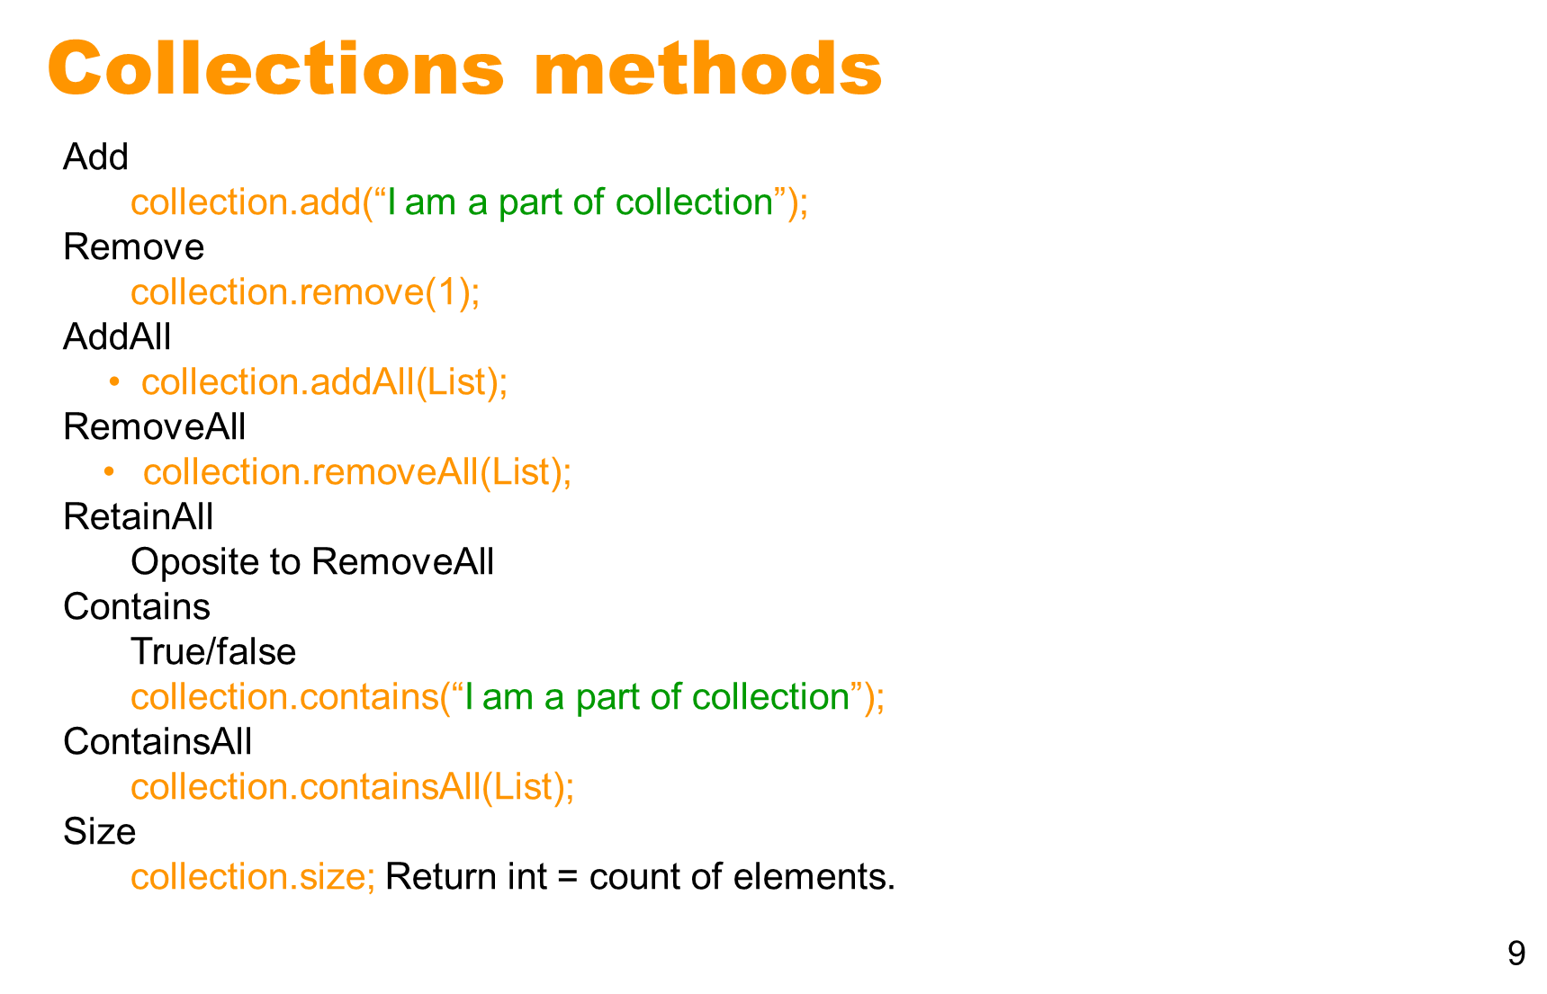

Slide 10
Generic Collections
It is possible to generify the various Collection and Map types and subtypes in the Java collection API.
Collection<String> stringCollection = new HashSet<String>();
10

Slide 11
Java Collection - List
It represents an ordered list of objects, meaning you can access the elements of a List in a specific order, or by an index too.
You can also add same value more than once into the list
List.add(“value1”)
List.add(“value1”)
Check class ListSample from module8
11

Slide 12

Activity 1 - List
In this activity, you will:
Open the file ‘ListActivity.java’ in the package sef.module8.activity.
Read the instructions and create the code to complete this program.

Slide 13
Java Collection - Set
It represents set of objects, meaning each element can only exists once.
HashSet is unordered set
As you keep on adding value in set, orders might change depending on its hashCode. hashCode is internally decided. There is a function in java called hashCode which returns the value of hashCode of element we enter in set
Based on that the order of our elements is decided
Check SetSample.java in module8
13

Slide 14
Activity 2 - Set
In this activity, you will:
Open the file ‘SetActivity.java’ in the package sef.module8.activity.
Read the instructions and create the code to complete this program.

Slide 15
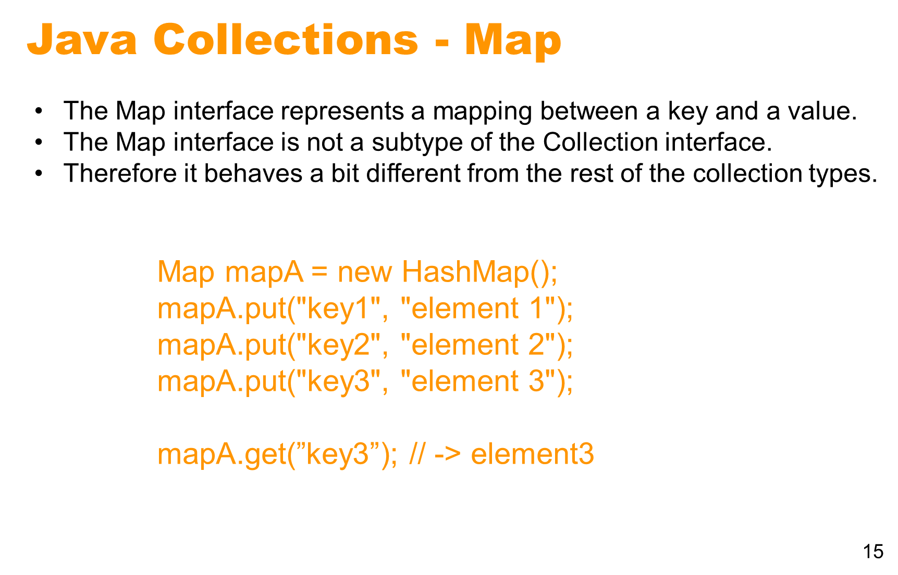
i
Refer to the MapSample.java in module 8 sample code.

Slide 16
Activity 3 - Set
In this activity, you will:
Open the file ‘MapActivity.java’ in the package sef.module8.activity.
Read the instructions and create the code to complete this program.

Slide 17
Questions and Comments
Notes:
Focus: Questions and Comments
Key Message: NA
Note to Instructor: Ask participants for any questions or comments they may have.
Transition: This brings us to the end of this module.

